Slide 1

Smart Seat Booking Platform
SeatHub
A full-stack MERN solution for intelligent office seat allocation and reservation

Slide 2

Project Overview
The Challenge
The Solution
A hybrid workforce requires intelligent seat management to optimize office space utilization while maintaining batch scheduling policies. Employees need flexible booking options within defined constraints.
A responsive web platform built with MERN stack that automates seat allocation, enforces company policies, and provides employees with seamless booking capabilities for their office visits.

Slide 3




System Architecture
Frontend
Backend
React with TypeScript for type safety and component-based architecture. Responsive UI with modern design patterns.
Node.js with Express for RESTful API endpoints. Business logic implementation and request handling.
Database
Authentication
MongoDB for flexible data modeling. Stores employee profiles, seat assignments, and booking history.
JWT-based secure login with role-based access control for different user permissions.

Slide 4

Core Business Logic
01
Batch Scheduling
Two batches (A & B) of 40 employees each follow alternating weekly patterns
02
Seat Allocation
50 total seats with 10 floating seats available for flexible booking
03
Policy Enforcement
Minimum 5 office days required over 2-week period with time restrictions
04
Dynamic Booking
Employees can release seats or book floating seats with 24-hour advance notice

Slide 5
Batch Scheduling System
Batch A
Batch B
Week 1: Monday, Tuesday, Wednesday
Week 2: Thursday, Friday
40 employees assigned to this batch
Designated seats for batch days
Week 1: Thursday, Friday
Week 2: Monday, Tuesday, Wednesday
40 employees assigned to this batch
Designated seats for batch days
Employees must work a minimum of 5 days over the two-week cycle, with flexible options to book floating seats on non-designated days.

Slide 6
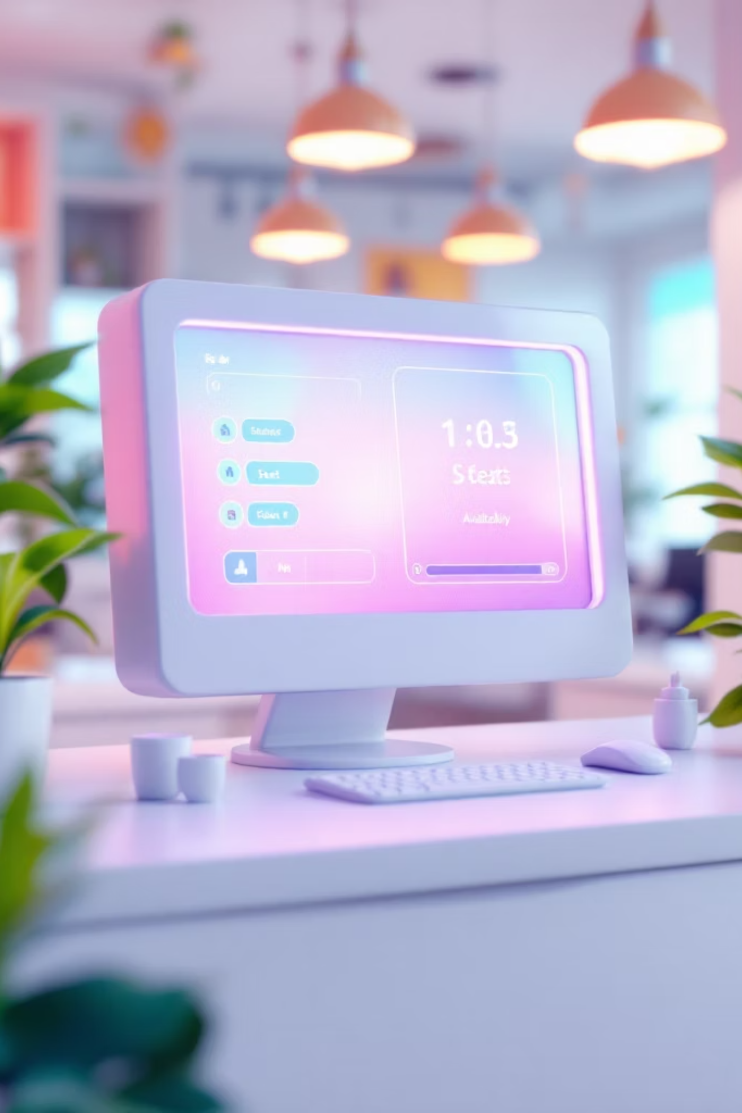
Seat Allocation Strategy
50
40
10
Total Seats
Designated Seats
Floating Seats
Total available workstations in office
Fixed allocation per batch cycle
Flexible booking for cross-batch days
80
Employees
Total workforce across both batches
Floating seats enable employees to work on non-designated days by booking one day in advance after 3 PM. This provides flexibility while maintaining office capacity constraints.

Slide 7




Key Features & Requirements
Smart Booking System
Seat Release Function
Employees can book seats for designated batch days automatically. Floating seat booking available one day in advance after 3 PM only.
Employees on leave can release their reserved seat for others to book, maximizing office utilization and reducing wasted capacity.
Policy Enforcement
Time Restrictions
System automatically blocks bookings on weekends and holidays. Enforces minimum 5-day requirement over two-week period.
Booking for non-designated days requires advance notice—only available after 3 PM for the following day.

Slide 8
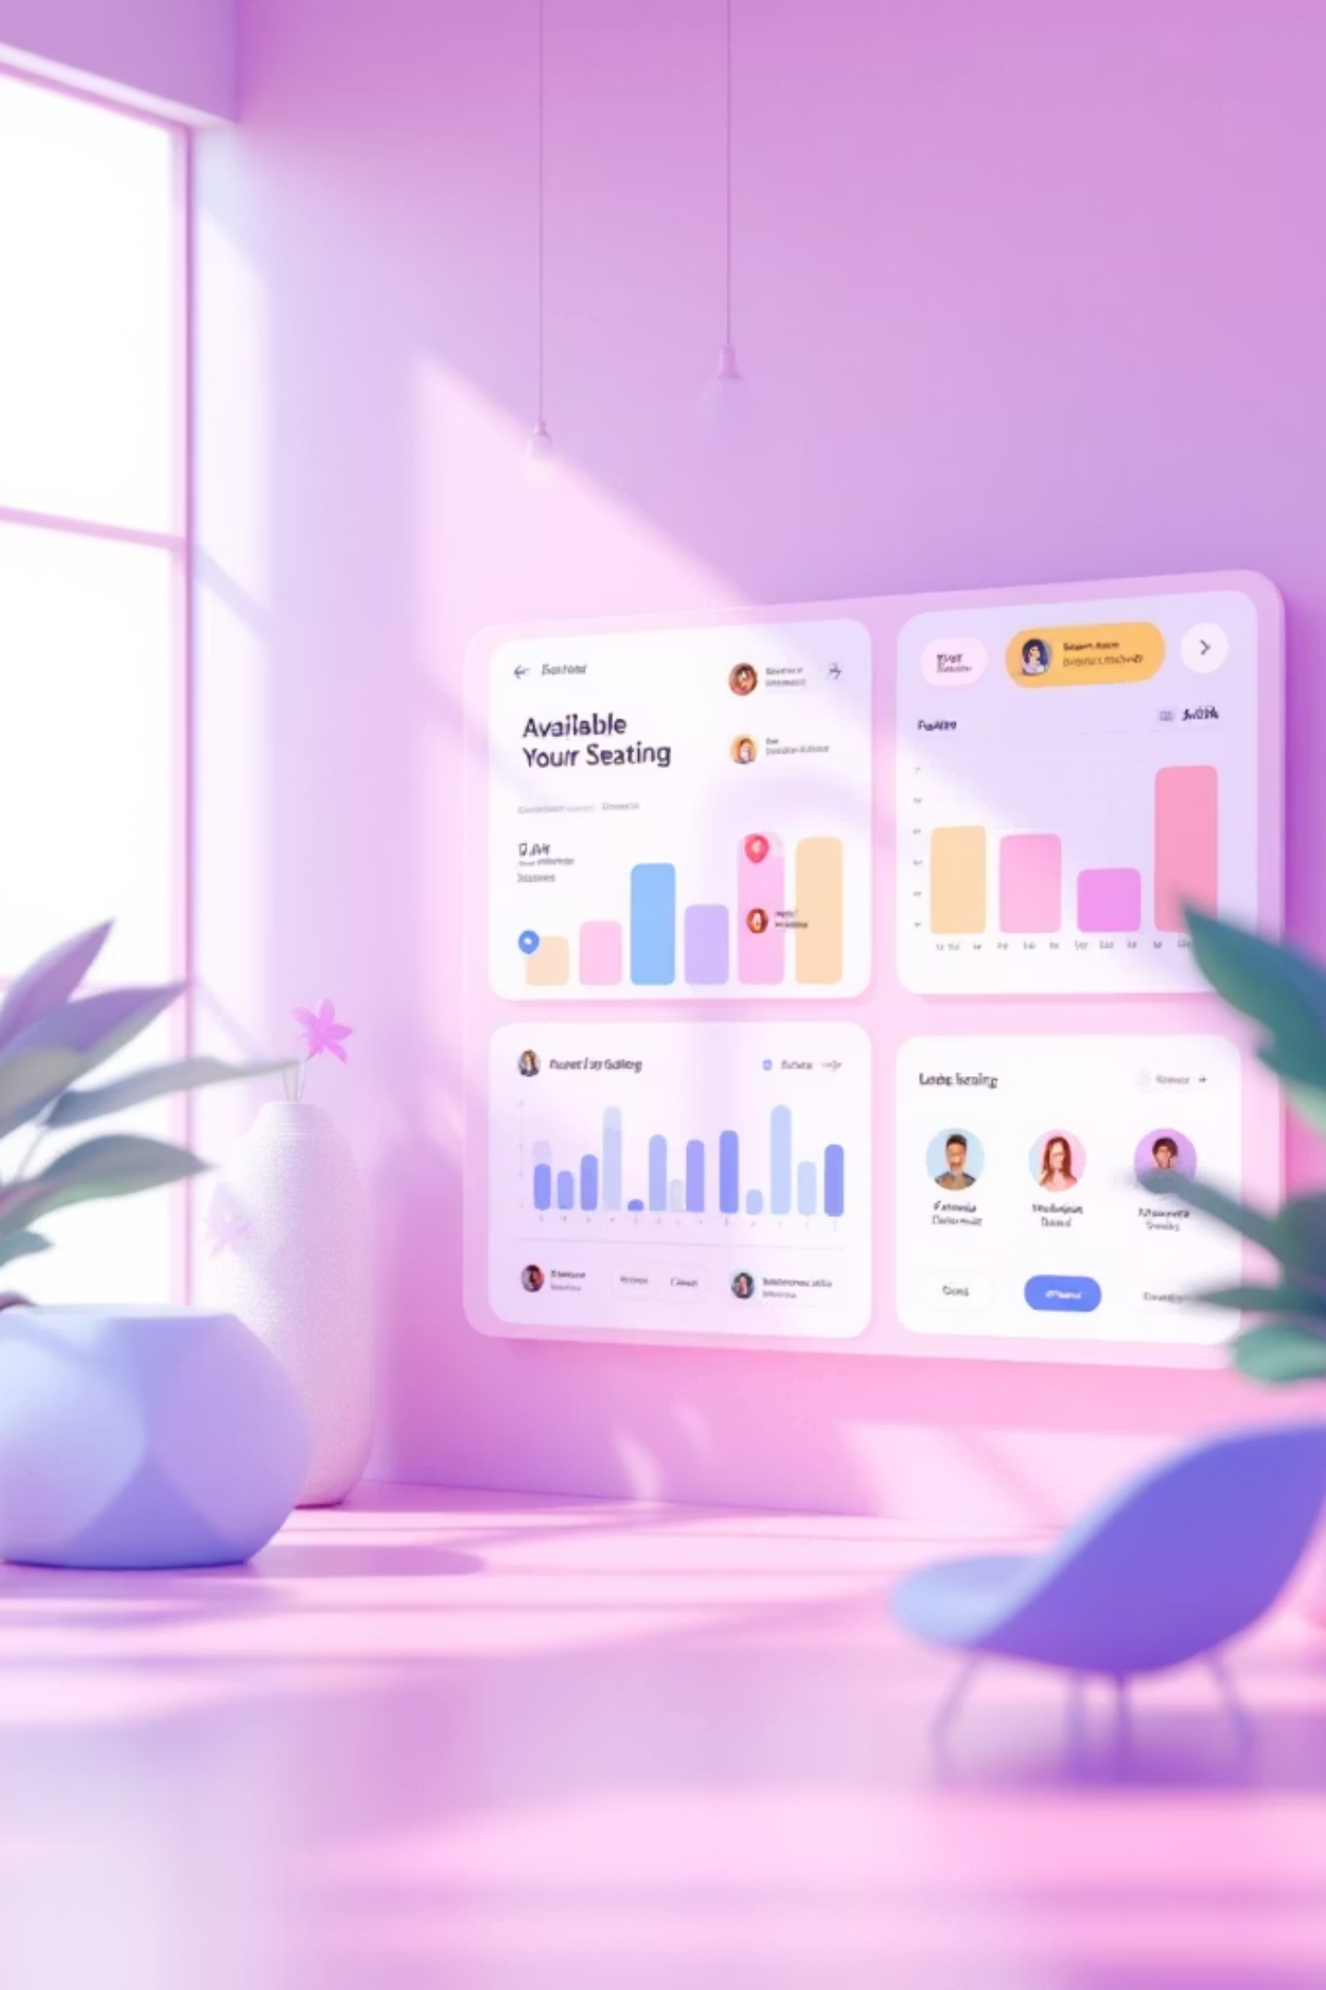
User Experience Design
Intuitive Dashboard
Mobile-First Design
Visual seat map showing availability with color-coded status indicators. Clean, professional interface optimized for quick bookings.
Fully responsive interface that works seamlessly on desktop, tablet, and mobile devices. Employees can book on the go.
Real-Time Updates
Live seat availability tracking with instant notifications. No double-booking conflicts through database transactions.

Slide 9




Technical Implementation
Database Schema
REST API
Mongoose models for Users, Seats, and Bookings with relationships and validation
Express routes for CRUD operations with middleware for authentication and authorization
React Components
Security
State management with Redux for shared application state and data flow
JWT tokens, input validation, and rate limiting to prevent abuse and ensure data integrity
API Endpoints Include:
Key Libraries:
GET /api/seats/available - List available seats
POST /api/bookings - Create new booking
DELETE /api/bookings/:id - Release seat
GET /api/bookings/my - View my bookings
Mongoose for ODM
Bcrypt for password hashing
Express-validator for input validation
JWT for authentication

Slide 10

System Benefits
Optimized Space Utilization
Maximizes office capacity through floating seats and seat release functionality, reducing wasted real estate.
Flexible Work Policy
Employees maintain work-life balance with ability to work additional days while meeting minimum office requirements.
Automated Compliance
System enforces company policies automatically—no manual oversight required for booking rules or time restrictions.
Enhanced Employee Experience
Self-service booking with real-time availability information reduces administrative friction and improves satisfaction.
This seat booking platform balances organizational efficiency with employee flexibility, creating a modern hybrid work environment that scales with your workforce.

Slide 11
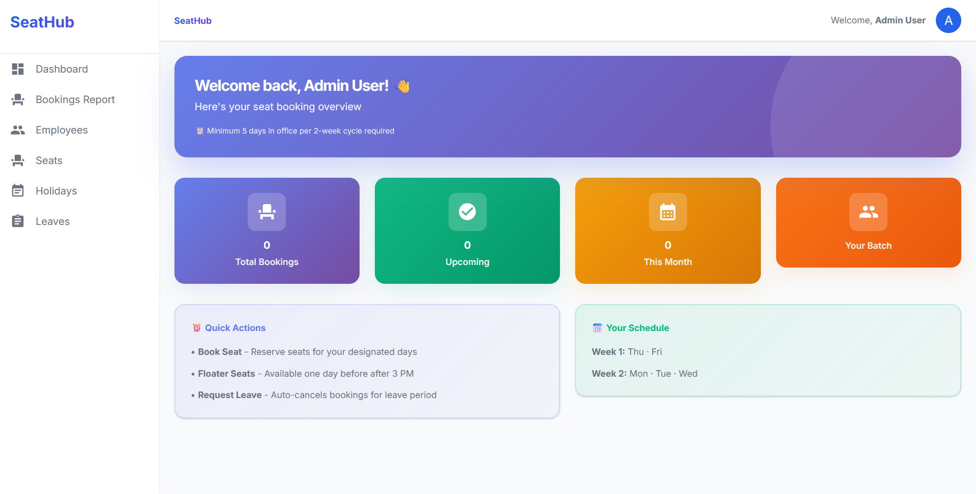
Glimpse of the project

Slide 12
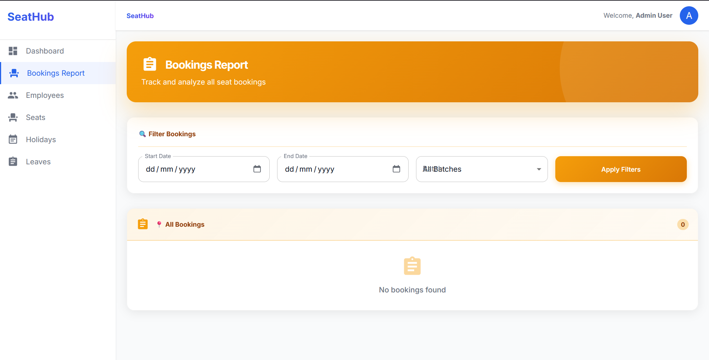
Glimpse of the project

Slide 13
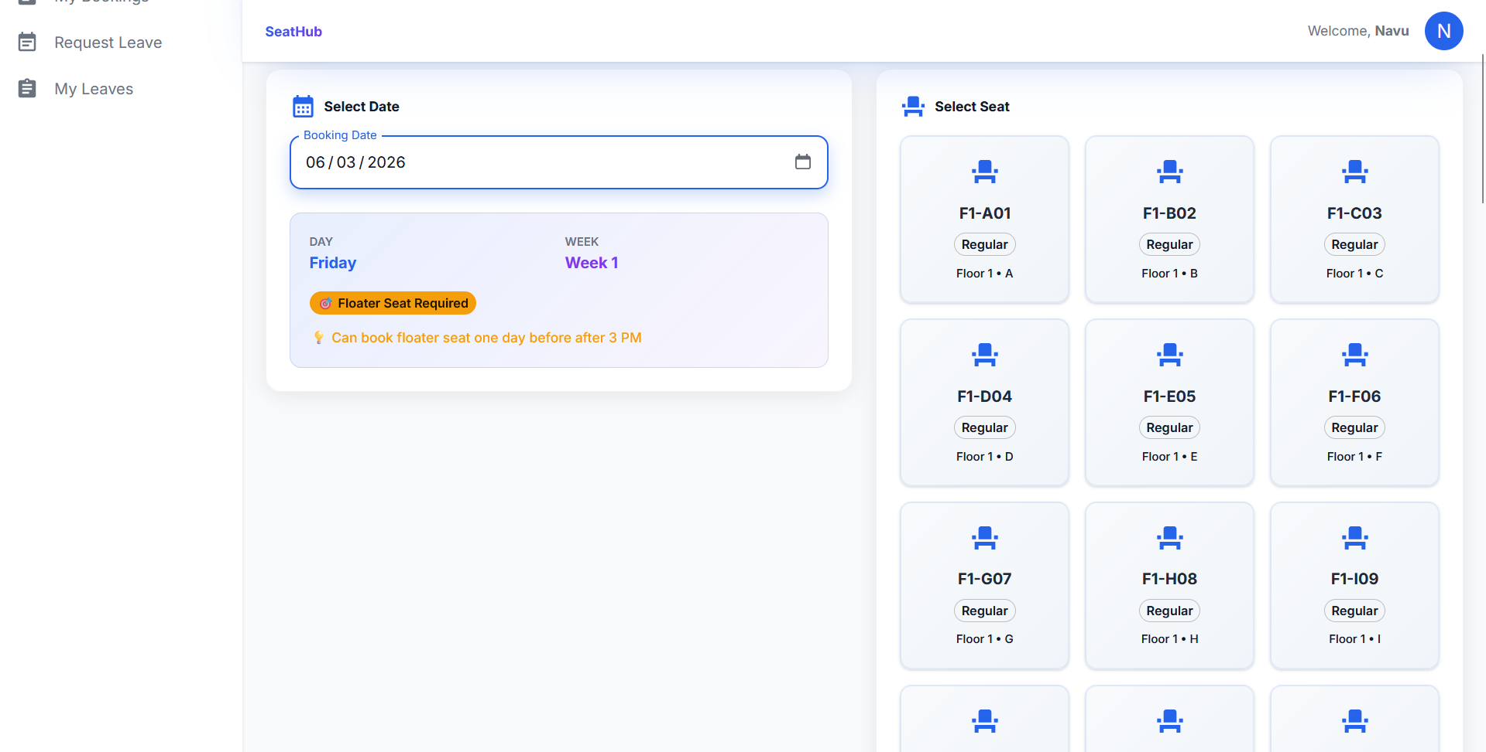
Glimpse of the project

Slide 14
Thank You

